Slide 2



Looking through the Prism
Stefan Dobrev
Stefan Dobrev
@ligaz
http://feeds.feedburner.com/ligaz
stefan.dobrev-at-telerik.com
stefan.dobrev-at-gmail.com

Slide 3

Why Prism ?

Slide 4
Some history
Prism v2, Feb 2009
Composite Application Guidance for WPF & Silverlight
Prism v1, June 2008
Composite Application Guidance for WPF
CAB, Dec 2005
Composite application block

Slide 5
What is Prism?
Prism – Composite Client Application Guidance for WPF and Silverlight
Library (*.dll)
Reference Implementation (StockTrader)
Documentation
Quick-Starts & How-To’s
Community – prism.codeplex.com

Slide 6

Design concepts / Core values
UI Composition
Modularity
Container
Multi-Targeting

Slide 7
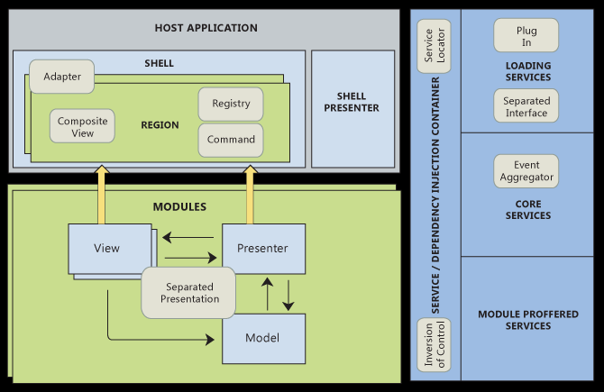
Patterns

Slide 8
Demo

Slide 9
Q&A
?

